Slide 1
Malicious Code and Application Attacks
Unit - 2

Slide 2
Outline
Malicious code
Password attacks
DOS Attack
Application attacks
Web application security
Reconnaissance(Exploration) attack
Masquerading attack

Slide 3
Malicious Code
Types
Basic types:
  Virus
  Worms
Several variants of the basic types exist:
  Trojan Horse
  Time Bomb
  Logic Bomb
  Rabbit
  Bacterium

Slide 4
Malicious Code: Viruses

Slide 5
Malicious Code: Viruses
Outline
What is a virus?
How does it spread?
How do viruses execute?
What do viruses exploit?
What are the controls for viruses?
How does Anti-Virus work?
Virus Examples
  Melissa Virus
  Shell Script

Slide 6
Malicious Code: Viruses
Definition
Definition: Malicious self-replicating software that attaches itself to other software.
Typical Behavior:
  Replicates within computer system, potentially attaching itself to every other program
  Behavior categories: e.g. Innocuous(harmless), Humorous(amusing), Data altering, Catastrophic

Slide 7
Malicious Code: Viruses
Propagation
Virus spreads by creating replica of itself and attaching itself to other executable programs to which it has write access.
  A true virus is not self-propagating and must be passed on to other users via e-mail, infected files/diskettes, programs or shared files
The viruses normally consist of two parts
  Replicator: responsible for copying the virus to other executable programs.
  Payload: Action of the virus, which may be benevolent(caring) such as printing a message or malicious such as destroying data or corrupting the hard disk.

Slide 8
Malicious Code: Viruses
Process
When a user executes an infected program (an executable file or boot sector), the replicator code typically executes first and then control returns to the original program, which then executes normally.
Different types of viruses:
  Polymorphic viruses: Viruses that modify themselves prior to attaching themselves to another program.
  Macro Viruses: These viruses use an application macro language (e.g., VB or VBScript) to create programs that infect documents and template.

Slide 9
Malicious Code: Viruses
Targets & Prevention
Vulnerabilities: All computers
Common Categories:
  Boot sector Terminate and Stay Resident (TSR)
  Application software Stealth (or Chameleon)
  Mutation engine Network Mainframe
Prevention
  Limit connectivity
  Limit downloads
  Use only authorized media for loading data and software
  Enforce mandatory access controls. Viruses generally cannot run unless host application is running

Slide 10
Malicious Code: Viruses
Protection
Detection
  Changes in file sizes or date/time stamps
  Computer is slow starting or slow running
  Unexpected or frequent system failures
  Change of system date/time
  Low computer memory or increased bad blocks on disks
Countermeasures:
  Contain, identify and recover
  Anti-virus scanners: look for known viruses
  Anti-virus monitors: look for virus-related application behaviors
  Attempt to determine source of infection and issue alert

Slide 11
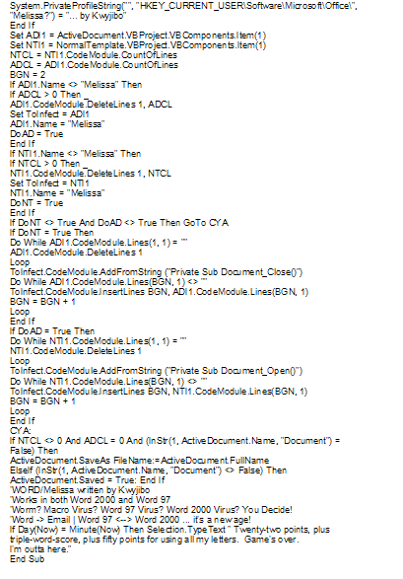
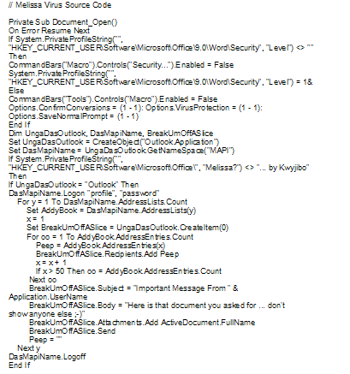
Malicious Code: Viruses
Melissa Virus Source Code

Slide 12
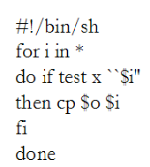
Malicious Code: Viruses
Virus Example
This virus example (shell script) has only 6 lines of code in comparison to the 105 lines of the Melissa Virus.
The script looks at each file in the current directory and tests if the file is an executable. All executables are replaced with a copy of this virus file.
Source: ``Virology 101'', Computing Systems Spring 1989, pp. 173-181.

Slide 13
Assignment 1: write script that reads folders and sub-folders on D-drive and append the text (.txt): “welcome to my malicious script” at the end of each text file if found”
Caution: please run carefully >> sample text file only. You can have specific folder access for this test purpose.
Any script: VB script, Shell Scirpt, C/C++ program, Pearl, Python ….

Slide 14
Malicious Code: Worms and Variants
Worms
Worms are another form of self-replicating programs that can automatically spread.
  They do not need a carrier program
  Replicate by spawning copies of themselves.
  More complex and are much harder to write than the virus programs.
Definition: Malicious software which is a stand-alone application (i.e. can run without a host application)
  They are more complex and are much harder to write than the virus programs.
Typical Behavior: Often designed to propagate through a network, rather than just a single computer

Slide 15
Malicious Code: Worms and Variants
Worm Prevention & Detection
Vulnerabilities: Multitasking computers, especially those employing open network standards
Prevention:
  Limit connectivity
  Employ Firewalls
Detection:
  Computer is slow starting or slow running
  Unexpected or frequent system failures
Countermeasures
  Contain, identify and recover
  Attempt to determine source of infection and issue alert

Slide 16
Malicious Code: Worms and Variants
Worm Examples
In November of 1988, a self propagating worm known as the Internet Worm was released onto the ARPANET by Robert Morris Jr. It 'attached' itself to the computer system rather than a program.
Process:
  The worm obtained a new target machine name from the host it had just infected and then attempted to get a shell program running on the target machine. The virus used several means to get the shell program running.
  It primarily exploited a bug in the send mail routine (a debug option left enabled in the program release) and a bug in the 'finger' routine.

Slide 17
Malicious Code: Worms and Variants
Worm Examples, cont’d.
  The shell program used several programs that downloaded password cracking programs.
  A common password dictionary and the system dictionary were used for password cracking
  The virus then attacked a new set of target hosts using any cracked accounts it may have obtained from the current host.
The virus was not intended to be malicious and did not harm any data on the systems it infected.
A bug prevented the worm from always checking to tell if a host was infected causing the worm to overload the host computers it infected.

Slide 18
Malicious Code: Worms and Variants
Trojan Horse
Definition: a worm which pretends to be a useful program or a virus which is purposely attached to a useful program prior to distribution
Typical Behaviors: Same as Virus or Worm, but also sometimes used to send information back to or make information available to perpetrator (culprit)
Vulnerabilities:
  Trojan Horses require user cooperation for executing their payload
  Untrained users are vulnerable
Prevention:
  User cooperation allows Trojan Horses to bypass automated controls thus user training is best prevention
Detection: Same as Virus and Worm
Countermeasures:
  Same as Virus and Worm
  An alert must be issued, not only to other system admins, but to all network users

Slide 19
Malicious Code: Worms and Variants
Time Bomb
Definition: A Virus or Worm designed to activate at a certain date/time
Typical Behaviors: Same as Virus or Worm, but widespread throughout organization upon trigger date
Vulnerabilities:
  Same as Virus and Worm
  Time Bombs are usually found before the trigger date
Prevention:
  Run associated anti-virus software immediately as available
Detection:
  Correlate user problem reports to find patterns indicating possible Time Bomb
Countermeasures:
  Attempt to determine source of infection and issue alert

Slide 20
Malicious Code: Worms and Variants
Logic Bomb
Definition:
  A Virus or Worm designed to activate under certain conditions
Typical Behaviors: Same as Virus or Worm
Vulnerabilities: Same as Virus and Worm
Prevention: Same as Virus and Worm
Detection: Correlate user problem reports indicating possible Logic Bomb
Countermeasures:
  Contain, identify and recover
  Determine source and issue alert

Slide 21
Malicious Code: Worms and Variants
Rabbit
Definition:
  A worm designed to replicate to the point of exhausting computer resources
Typical Behaviors:
  Rabbit consumes all CPU cycles, disk space or network resources, etc.
Vulnerabilities: Multitasking computers, especially those on a network
Prevention: Limit connectivity, Employ Firewalls
Detection:
  Computer is slow starting or running
  Frequent system failures
Countermeasures:
  Contain, identify and recover
  Determine source and issue alert

Slide 22
Malicious Code: Worms and Variants
Bacterium
Definition:
  A virus designed to attach itself to the OS in particular (rather than any application in general) and exhaust computer resources, especially CPU cycles
Typical Behaviors: Operating System consumes more and more CPU cycles, resulting eventually in noticeable delay in user transactions
Vulnerabilities: Older versions of operating systems are more vulnerable than newer versions since hackers have had more time to write Bacterium
Prevention: Limit write privileges and opportunities to OS files, System administrators should work from non-admin accounts whenever possible.
Detection:
  Changes in OS file sizes, date/time stamps
  Computer is slow in running
  Unexpected or frequent system failures
Countermeasures
  Anti-virus scanners: look for known viruses
  Anti-virus monitors: look for virus-related system behaviors

Slide 23
Malicious Attacks
Outline
What is a buffer overflow attack?
What is a Denial of Service (DOS) attack?
What is a tunneling attack?
What is a trap door?
What is SPAM?

Slide 24
Malicious Attacks
Buffer Overflow
Definition:
  Attacker tries to store more information on the stack than the size of the buffer and manipulates the memory stack to execute malicious code
  Programs which do not have a rigorous memory check in the code are vulnerable to this attack
Typical Behaviors:
  Varied attack and can be used for obtaining privileges on a machine or for denial-of-service on a machine
Vulnerabilities:
  Takes advantage of the way in which information is stored by computer programs. Programs which do not have a rigorous memory check in the code are vulnerable to this attack

Slide 25
Malicious Attacks
Buffer Overflow, cont’d.
This attack takes advantage of the way in which information is stored by computer programs
An attacker tries to store more information on the stack than the size of the buffer
Bottom of
Memory
Fill
Direction
Bottom of
Memory
Fill
Direction
Buffer 2
Local Variable 2
Buffer 2
Local Variable 2
Buffer 1
Local Variable 1
Machine Code:
execve(/bin/sh)
Buffer 1 Space Overwritten
Return Pointer
New Pointer to
Exec Code
Return Pointer Overwritten
Function Call
Arguments
Function Call
Arguments
Top of
Memory
Top of
Memory
Normal Stack
Smashed Stack

Slide 26
Malicious Attacks
Denial of Service (DOS)
Definition:
  Attack through which a person can render a system unusable or significantly slow down the system for legitimate users by overloading the system so that no one else can use it.
Typical Behaviors:
  Crashing the system or network: Send the victim data or packets which will cause system to crash or reboot.
  Exhausting the resources by flooding the system or network with information. Since all resources are exhausted others are denied access to the resources
  Distributed DOS attacks are coordinated denial of service attacks involving several people and/or machines to launch attacks

Slide 27
Malicious Attacks
Denial of Service: Popular Programs
Ping of Death: is a type of denial of service (DoS) attack in which an attacker attempts to crash, destabilize, or freeze the targeted computer or service.
SSPing: Denial of Service attack that involves sending a series of highly fragmented, oversized ICMP data packets.
Land: A LAND Attack is a Layer 4 Denial of Service (DoS) attack in which, the attacker sets the source and destination information of a TCP segment to be the same. A vulnerable machine will crash or freeze due to the packet being repeatedly processed by the TCP stack.
Smurf: The Smurf attack is a distributed denial-of-service attack in which large numbers of Internet Control Message Protocol (ICMP) packets with the intended victim's spoofed source IP are broadcast to a computer network using an IP broadcast address
SYN Flood: A SYN flood is a form of denial-of-service attack in which an attacker sends a succession of SYN requests to a target's system in an attempt to consume enough server resources
CPU Hog: creates a do-nothing loop that causes the CPU to stay at 100% utilization, then sets itself to the highest priority on the processor scheduler
RPC Locator: Remote Procedure Call (RPC) Locator service manages the RPC name service database
Jolt2: cause a Denial of Service attack against Windows based machines – the attack causes the target machine to consume 100% of the CPU time on processing of illegal packets

Slide 28
Malicious Attacks
Tunneling
Definition:
  Attempts to get “under” a security system by accessing very low-level system functions (e.g., device drivers, OS kernels)
Typical Behaviors:
  Behaviors such as unexpected disk accesses, unexplained device failure, halted security software, etc.
Vulnerabilities:
  Tunneling attacks often occur by creating system emergencies to cause system re-loading or initialization.
Prevention:
  Design security and audit capabilities into even the lowest level software, such as device drivers, shared libraries, etc.
Detection:
  Changes in date/time stamps for low-level system files or changes in sector/block counts for device drivers
Countermeasures:
  Patch or replace compromised drivers to prevent access
  Monitor suspected access points to attempt trace back.

Slide 29
Malicious Attacks
Trap Door
Definition:
  System access for developers inadvertently(unintentionally) left available after software delivery
Typical Behaviors
  Unauthorized system access enables viewing, alteration or destruction of data or software
Vulnerabilities
  Software developed outside organizational policies and formal methods
Prevention:
  Enforce defined development policies
  Limit network and physical access
Detection
  Audit trails of system usage especially user identification logs
Countermeasures
  Close trap door or monitor ongoing access to trace pack to perpetrator(culprit)

Slide 30
Malicious Attacks
Spam
Definition
  System flood with incoming message or other traffic to cause crashes, eventually traced to overflow buffer or swap space
Vulnerabilities:
  Open source networks especially vulnerable
Prevention:
  Require authentication fields in message traffic
Detection:
  Partitions, network sockets, etc. for overfull conditions.

Slide 31
Unintentional Threats
Outline
Equipment Malfunction
Software Malfunction
User Error
Failure of Communication Services
Failure to Outsource Operations
Loss or Absence of Key Personnel
Misrouting/Re-routing of Messages
Natural Disasters
Environmental Conditions

Slide 32
Unintentional Threats
Equipment Malfunction
Definition:
  Hardware operates in abnormal, unintended
Typical Behaviors:
  Immediate loss of data due to abnormal shutdown. Continuing loss of capability until equipment is repaired
Vulnerabilities:
  Vital peripheral equipment is often more vulnerable that the computers themselves
Prevention:
  Replication of entire system including all data and recent transaction
Detection:
  Hardware diagnostic systems

Slide 33
Unintentional Threats
Software Malfunction
Definition: Software behavior is in conflict with intended behavior
Typical Behaviors:
  Immediate loss of data due to abnormal end
  Repeated failures when faulty data used again
Vulnerabilities: Poor software development practices
Prevention:
  Enforce strict software development practices
  Comprehensive software testing procedures
Detection: Use software diagnostic tools
Countermeasures
  Backup software
  Good software development practices

Slide 34
Unintentional Threats
User Error
Definition:
  Inadvertent alteration, manipulation or destruction of programs, data files or hardware
Typical Behaviors
  Incorrect data entered into system or incorrect behavior of system
Vulnerabilities
  Poor user documentation or training
Prevention:
  Enforcement of training policies and separation of programmer/operator duties
Detection
  Audit trails of system transactions
Countermeasures
  Backup copies of software and data
  On-site replication of hardware

Slide 35
Unintentional Threats
Failure of Communications Services
Definition: Disallowing of communication between various sites, messages to external parties, access to information, applications and data stored on network storage devices.
Typical Behaviors
  Loss of communications service can lead to loss of availability of information.
  Caused by accidental damage to network, hardware or software failure, environmental damage, or loss of essential services
Vulnerabilities
  Lack of planning and implementation of communications cabling
  Inadequate incident handling
Prevention:
  Maintain communications equipment
Countermeasures
  Use an Uninterrupted Power Supply (UPS)
  Perform continuous back-ups.
  Plan and implement communications cabling well
  Enforce network management

Slide 36
Unintentional Threats
Failure to Outsource Operations
Definition: Outsourcing of operations must include security requirements and responsibilities
Typical Behaviors
  Failure of outsourced operations can result in loss of availability, confidentiality and integrity of information
Vulnerabilities
  Unclear obligations in outsourcing agreements
  Non business continuity plans or procedures for information and information asset recovery.
  Back up files and systems not available.
Prevention:
  Create clear outsourcing agreements
Countermeasures
  Implement an effective business continuity plan
  Back up files and system

Slide 37
Unintentional Threats
Loss or Absence of Key Personnel
Definition:
  Critical personnel are integral to the provision of company services
Typical Behaviors:
  Absence or loss of personnel can lead to loss of availability, confidentiality, integrity, and reliability.
Vulnerabilities:
  No backup of key personnel
  Lack of succession planning
Prevention
  Maintain redundancy of personnel skills
Countermeasures
  Document procedures
  Plan for succession

Slide 38
Unintentional Threats
Misrouting/Re-routing of messages
Definition:
  Accidental directing or re-routing of messages
Typical Behaviors:
  Can lead to loss of confidentiality of messages are not protected and loss of availability to the intended recipient.
Vulnerabilities:
  Non-encrypted sensitive data
  Lack of message receipt proof
Prevention:
  Train users in policies
Countermeasures:
  Encrypt sensitive data
  User receipts

Slide 39
Unintentional Threats
Natural Disasters
Definition: Environmental condition which causes catastrophic damage. E.g. earthquakes, fire, flood, storms, tidal waves.
Typical Behaviors
  Physical Damage
  Loss of data, documentation, and equipment
  Loss of availability of information (leads to loss of trust, financial loss, legal liability)
Vulnerabilities
  Storing data and processing facilities in known location where natural disasters tend to occur
  No fire/smoke detectors
  No business continuity plans
  Back-up files and systems are unavailable

Slide 40
Unintentional Threats
Natural Disasters, cont’d.
Prevention:
  Location is not known to be a place of natural disasters
Detection
  Weather Advisories
  Fire/Smoke Alarms
Countermeasures
  Backup copies of software and data
  Storage of data is located in another location
  Have a business continuity plan in place

Slide 41
Unintentional Threats
Environmental Conditions
Definition: Negative effects of environmental conditions. E.g. contamination, electronic interference, temperature and humidity extremes, power failure, power fluctuations
Typical Behaviors
  Chemical corrosion
  Introduction of glitches or errors in data
  Equipment failure
  Availability of information can be compromised
  Adverse Health Effects

Slide 42
Attacks
An attack is the deliberate act that exploits vulnerability
It is accomplished by a threat-agent to damage or steal an organization’s information or physical asset
  An exploit is a technique to compromise a system
  A vulnerability is an identified weakness of a controlled system whose controls are not present or are no longer effective
  An attack is then the use of an exploit to achieve the compromise of a controlled system

Slide 43
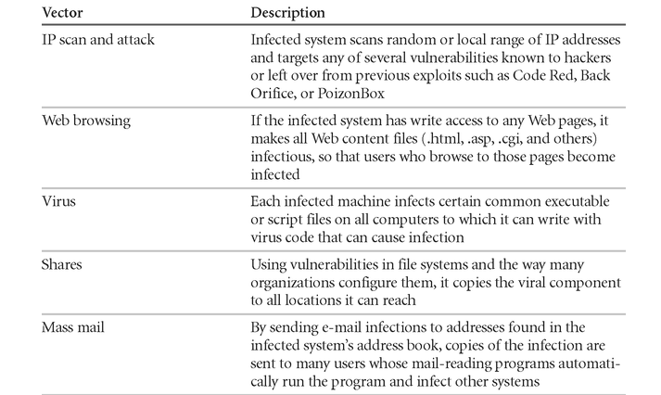
Attack replication Vectors

Slide 44
Attack Descriptions
IP Scan and Attack – Compromised system scans random or local range of IP addresses and targets any of several vulnerabilities known to hackers or left over from previous exploits
Web Browsing - If the infected system has write access to any Web pages, it makes all Web content files infectious, so that users who browse to those pages become infected
Virus - Each infected machine infects certain common executable or script files on all computers to which it can write with virus code that can cause infection

Slide 45
Attack Descriptions
Unprotected Shares - using file shares to copy virus component to all reachable locations
Mass Mail - sending e-mail infections to addresses found in address book
Back Doors - Using a known or previously unknown and newly discovered access mechanism, an attacker can gain access to a system or network resource

Slide 46
Attack Descriptions
Password Crack - Attempting to reverse calculate a password
Brute Force - The application of computing and network resources to try every possible combination of options of a password
Dictionary - The dictionary password attack narrows the field by selecting specific accounts to attack and uses a list of commonly used passwords (the dictionary) to guide guesses

Slide 47
Attack Descriptions
Denial-of-service (DoS) –
  attacker sends a large number of connection or information requests to a target
  so many requests are made that the target system cannot handle them successfully along with other, legitimate requests for service
  may result in a system crash, or merely an inability to perform ordinary functions
Distributed Denial-of-service (DDoS) - an attack in which a coordinated stream of requests is launched against a target from many locations at the same time

Slide 48
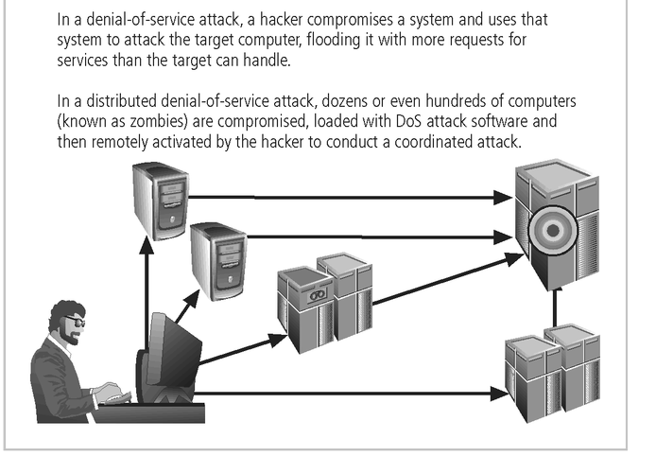

Slide 49
Attack Descriptions
Spoofing - technique used to gain unauthorized access whereby the intruder sends messages to a computer with an IP address indicating that the message is coming from a trusted host
Man-in-the-Middle - an attacker sniffs packets from the network, modifies them, and inserts them back into the network
Spam - unsolicited commercial e-mail - while many consider spam a nuisance(pain) rather than an attack, it is emerging as a vector for some attacks

Slide 50
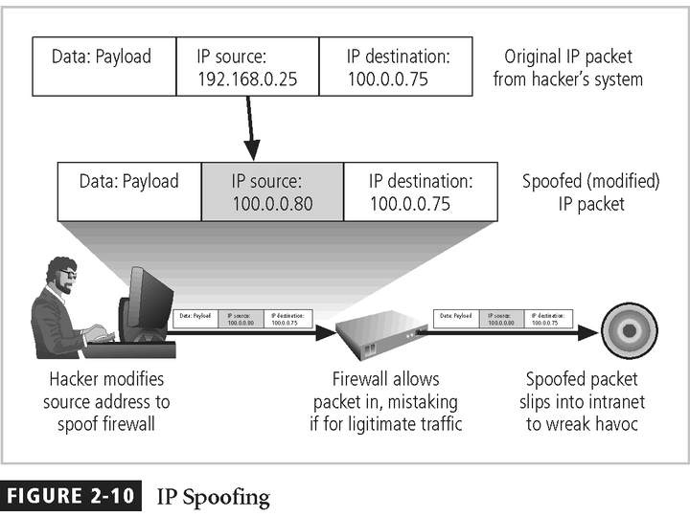

Slide 51
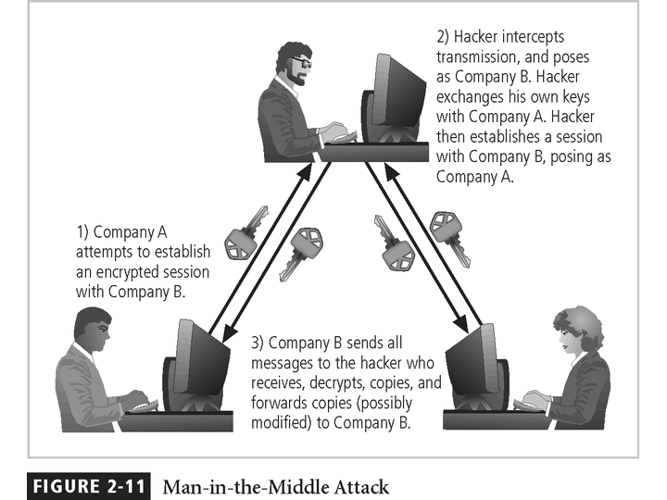

Slide 52
Attack Descriptions
Mail-bombing - another form of e-mail attack that is also a DoS, in which an attacker routes large quantities of e-mail to the target
Sniffers - a program and/or device that can monitor data traveling over a network. Sniffers can be used both for legitimate network management functions and for stealing information from a network
Social Engineering - within the context of information security, the process of using social skills to convince people to reveal access credentials or other valuable information to the attacker

Slide 53
Attack Descriptions
“People are the weakest link. You can have the best technology; firewalls, intrusion-detection systems, biometric devices ... and somebody can call an unsuspecting employee. That's all They got everything.”
Buffer Overflow –
  application error occurs when more data is sent to a buffer than it can handle
  when the buffer overflows, the attacker can make the target system execute instructions, or the attacker can take advantage of some other unintended consequence of the failure

Slide 54
Malware Summary
Malware covers all kinds of intruder software
Code Type | Characteristics
Virus | Attaches itself to program and copies to other program
Trojan Horse | Contains unexpected, additional functionality
Logic Bomb | Triggers action when condition occurs
Time Bomb | Triggers action when specified time occurs
Trapdoor | Allows unauthorized access to functionality
Worm | Propagates copies of itself through the network
Root Kit | Hooks standard OS calls to hide data

Slide 55
Rootkits
A rootkit is a stealthy type of malware designed to hide the existence of certain processes or programs from normal methods of detection and enable continued privileged access to a computer
Insert file filters to cause files or directories disappear from normal listings
Techniques apply equally well to Linux and Mac
Detection is difficult because a rootkit may be able to subvert (disrupt) the software that is intended to find it.
Detection methods include using an alternative and trusted operating system, behavioral-based methods, signature scanning, difference scanning, and memory dump analysis.
Removal can be complicated or practically impossible, especially in cases where the rootkit resides in the kernel

Slide 56
Anti-virus software
Initially: signature detection.
But signatures are not enough!
  Pattern matching
  Automatic learning
  Environment emulation
  Neural networks
  Data mining
  Bayes networks

Slide 57
Signature Avoiding Viruses
Polymorphic Virus produces varying but operationally equivalent copies of itself
  Use alternative but equivalent instructions
  Gets around signature scanners.
Stealth Virus actively tries to hide all signs of its presence
  A virus can intercept calls to read a file and return correct values about file sizes etc. Brain Virus

Slide 58
Sandboxes
A sandbox is a security mechanism
for safely running untrusted programs
  Provides a tightly-controlled set of resources for guest programs to run in, such as space on disk and memory. Network access, the ability to inspect the host system or read from input devices is usually disallowed or heavily restricted. E.g. virtual machine.
Examples of sandboxes are:
  Applets are self-contained programs that run in a virtual machine or scripting language interpreter that does the sandboxing, for example in the browser.
  Jails are a special kind of resource limit imposed on programs by the operating system.

Slide 59
The Threat of Monopoly
Another reason for the prevalence (occurance) of malware is the homogeneity of software
  Most computers run Windows, MS Office, MS Outlook Express, MS Internet Explorer
  This makes the attacker’s job very easy.
In contrast, in the linux world, there is a plethora (excess) of rival distributions, office suites, email clients, browsers.
  Makes the attacker’s job much, much harder!

Slide 60
Open-source vs closed source
It is often argued that
  OS more secure because vulnerabilities have a much higher chance of being spotted, since hundreds of people around the world are scrutinising the source code.
  CS less secure because very few people have access to the source code.
But one can also argue that
  OS less secure because attackers can see the code and find vulnerabilities to exploit.
  CS more secure because attacker doesn’t have access to the source code.
However, this argument is “security through obscurity(anonymity)” and should be rejected.

Slide 61
Password -I
Password cracking is the process of recovering passwords from data that has been stored in or transmitted by a computer system
Passwords to access computer systems are usually stored in a database so the system can perform password verification when a user attempts to login or access a restricted resource.
To preserve confidentiality of system passwords, the password verification data is typically not stored in cleartext form, but instead a one-way function is applied to the password, possibly in combination with other data, and the resulting value is stored.

Slide 62
Password Types
Password that contain only letters
Password that contain only numbers
Password that contain only special characters
Password that contain letters and numbers
Password that contain only letters and special characters
Password that contain only special characters and numbers
Password that contain letters, special characters and numbers

Slide 63
Types of password Attacks
Brute force attack: It tries various combinations of usernames and passwords again and again until it gets in
Dictionary attack: A dictionary attack is attempt to guess passwords by using well-known words or phrases
Hybrid attack: blend of both a dictionary attack method as well as brute force attack
Social engineering: is an attack vector that relies heavily on human interaction and often involves manipulating people into breaking normal security procedures and best practices in order to gain access to systems, networks or physical locations, or for financial gain.
Shoulder surfing: a type of social engineering technique used to obtain information such as personal identification numbers (PINs), passwords and other confidential data by looking over the victim's shoulder
Dumpster diving: Alternatively referred to as trashing, dumpster diving is the practice of digging through a company's trash bins or dumpsters to gain information
Zero day attack: A zero day exploit is a cyber attack that occurs on the same day a weakness is discovered in software.

Slide 64
Types of password Attacks
Key Logger Attack: A hacker uses a program to track all of a user’s keystrokes.
Rainbow table attack: attack that attempts to discover the password from the hash. However, they use rainbow tables, which are huge databases of precomputed hashes.
Fishing attack: involved tricking a victim into taking some action that benefits the attacker.
Offline Cracking: is an attempt to recover one or more passwords from a password storage file that has been recovered from a target

Slide 65
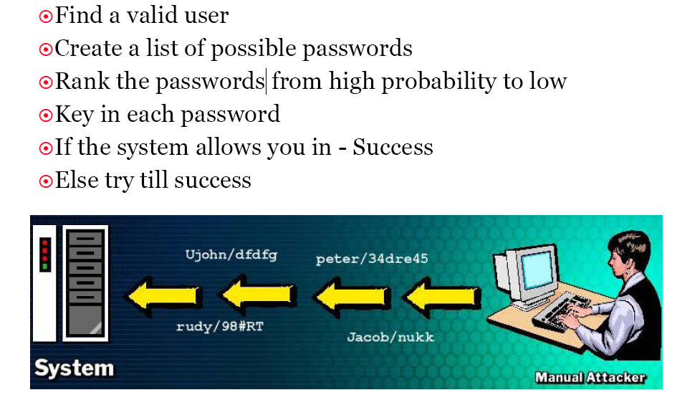
Manual Password Cracking
Source: EC Council

Slide 66
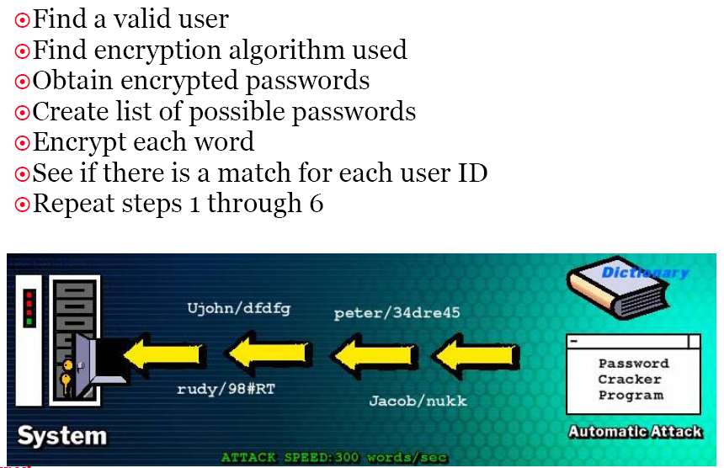
Automatic Password Cracking
Source: EC Council

Slide 67
Password Cracking Countermeasures
Enforce 7-12 character alphanumeric passwords (Preferably with special characters).
Set the password change policy to 30 days.
Physically isolate and protect the server
Store encrypted hashes in the disk
Monitor the server logs for brute force attacks on user accounts
Keep computer clean from malware ( Trojan horse, Keylogger, spyware etc.)

Slide 68
Levels of Security
Human level: Corrupt/careless User
Network/User Interface
Database application program
Database system
Operating System
Physical level

Slide 69
Network Level Security
Must use encryption to prevent
  Eavesdropping: unauthorized reading of messages
  Masquerading:
    Pretending to be an authorized user
    Sending messages supposedly from authorized users

Slide 70
DoS and DDoS

Slide 71
Definition
Denial-of-service (DoS) attack aims at disrupting the authorized use of networks, systems, or applications
  by sending messages which exhaust service provider’s resources ( network bandwidth, system resources, application resources)
Distributed denial-of-service (DDoS) attacks employ multiple (dozens to millions) compromised computers to perform a coordinated and widely distributed DoS attack
Victims of (D)DoS attacks
  service-providers (in terms of time, money, resources, good will)
  legitimate service-seekers (deprived of availability of service itself)
  Zombie systems(Penultimate and previous layers of compromised systems in DDoS)

Slide 72
Approaches to DoS attacks
Internet designed for minimal-processing and best-effort forwarding any packet
  Make shrewd(sharp) use of flaws in the Internet design and systems
  Unregulated forwarding of Internet packets : Vulnerability ,Flooding
Vulnerability attack
  Vulnerability : a bug in implementation or a bug in a default configuration of a service
  Malicious messages (exploits) : unexpected input that utilize the vulnerability are sent
  Consequences :
    The system slows down or crashes or freezes or reboots
    Target application goes into infinite loop
    Consumes a vast amount of memory
  Ex : Ping of death, teardrop attacks, etc.

Slide 73
Approaches to DoS attack - II
Flooding attack
  Work by sending a vast number of messages whose processing consumes some key resource at the target
  The strength lies in the volume, rather than the content
  Implications :
    Flow of traffic is large enough to consume victim’s resources
    Send with high packet rate
    These attacks are more commonly DDoS

Slide 74
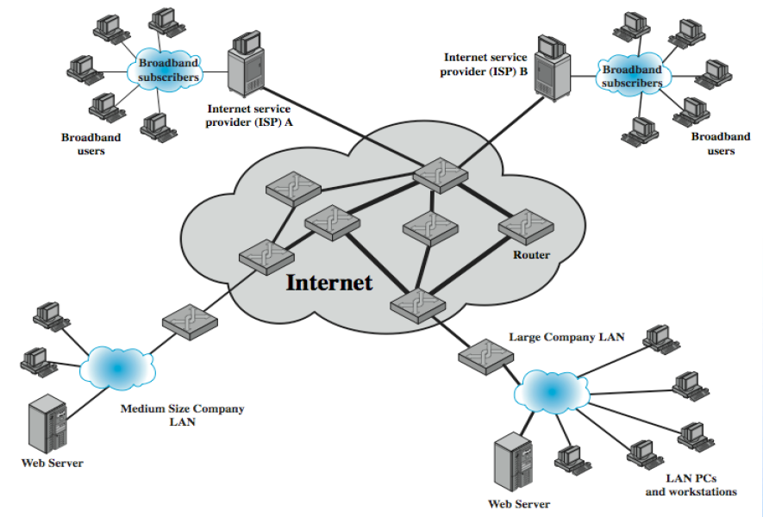
Classical DoS attacks
Simplest classical DoS attack: Flooding attack on an organization
  Ping flood attack
Service denied to legitimate users

Slide 75
Flooding attacks
Goal : Bombarding large number of malicious packets at the victim, such that processing of these packets consumes resources
Any type of network packet can be used
  Attack traffic made similar to legitimate traffic
Valid traffic has a low probability of surviving the discard caused by flood and hence accessing the server
Some ways of flooding :
  To overload network capacity on some link to a server
  To overload server’s ability to handle and respond to this traffic
The larger the packet, the more effective the attack

Slide 76
Types of flooding attacks
Classified based on type of network protocol used to attack
ICMP flood
  Uses ICMP packets , ex: ping flood using echo request
  Typically allowed through, some required
UDP flood
  Exploits the target system’s diagnostic echo services to create an infinite loop between two or more UDP services
TCP SYN flood
  Use TCP SYN (connection request packets)

Slide 77
Distributed Denial-of-service
Attacker uses multiple compromised user work stations/PCs for DoS by:
  Utilising vulnerabilities to gain access to these systems
  Installing malicious backdoor programs , thereby making zombies
  Creating botnets: large collection of zombies under the control of attacker
Generally, a control hierarchy is used to create botnets
  Handlers: The initial layer of zombies that are directly controlled by the attacker
  Agent systems: Subordinate zombies that are controlled by handlers
  Attacker sends a single command to handler, which then automatically forwards it to all agents under its control
Notes:
A botnet (also known as a zombie army) is a number of Internet computers that, although their owners are unaware of it, have been set up to forward transmissions (including spam or viruses) to other computers on the Internet.

Slide 78
DDoS control hierarchy
Example: Tribe Flood Network (TFN)
  Relied on large number of compromised systems and layered command structure
Command-line program
Trojan Program

Slide 79
DDoS attack toolkits
Some popular DDoS programs
  Trinoo, TFN, Stacheldraht, Shaft, TFN2K, Mstream, Trinity, Phatbot
Blended threat toolkits: Include some (all) of the following components
  Windows network service program
  Scanners
  Single-threaded DoS programs
  An FTP server
  An IRC file service
  An IRC DDoS Bot
  Local exploit programs
  Remote exploit programs
  System log cleaners

Slide 80
DoS Detection Techniques
Goal: To detect and distinguish malicious packet traffic from legitimate packet traffic
Flash crowds: High traffic volumes may also be accidental
Highly publicized websites: (unpredictable) news aggregation site
  Much-awaited events: (Predictable) Olympics, SLC result etc.
There is no innate(essential) Internet mechanism for performing malicious traffic discrimination
Once detected, vulnerability attacks are easy to be addressed
If vulnerability attacks volume is so high that it manifests as flooding attack, very difficult to handle

Slide 81
Vulnerability Attack Detection Techniques
Detection techniques can be installed locally or remotely
  Locally : detectors placed at potential victim resource or at a router or firewall within the victim’s subnetwork
  Remotely: To detect propagating attacks
Attack defined by detection methods:
  an abnormal and noticeable deviation of some statistic of the monitored network traffic workload
  Proper choice of statistic is crutial
Also can use statistical detection methods e.g. activity profiling

Slide 82
Defenses against DoS attacks
DoS attacks cannot be prevented entirely
Impractical to prevent the flash crowds without compromising network performance
Three lines of defense against (D)DoS attacks
  Attack prevention and preemption
  Attack detection and filtering
  Attack source traceback and identification

Slide 83
Defenses against DoS attacks -II
Block IP broadcasts
Block suspicious services & combinations
Manage application attacks with “puzzles” to distinguish legitimate human requests
Good general system security practices
Use mirrored and replicated servers when high performance and reliability required

Slide 84
Responding to attacks
Need good incident response plan
  With contacts for ISP
  Needed to impose traffic filtering upstream
  Details of response process
Have standard antispoofing, rate limiting, directed broadcast limiting filters
Ideally have network monitors and IDS
  To detect and notify abnormal traffic patterns

Slide 85
Responding to attacks - II.
Identify the type of attack
  Capture and analyze packets
  Design filters to block attack traffic upstream
  Identify and correct system application bugs
Have ISP trace packet flow back to source
  May be difficult and time consuming
  Necessary if legal action desired
Implement contingency plan
Update incident response plan
Homework: Install NMAP and play on it

Slide 86
Application Attacks

Slide 87
OWASP Top 10 Application Attacks
Application Threat | Negative Impact | Example Impact
Cross Site scripting | Identity Theft, Sensitive Information Leakage, … | Hackers can impersonate legitimate users, and control their accounts.
Injection Flaws | Attacker can manipulate queries to the DB / LDAP / Other system | Hackers can access backend database information, alter it or steal it.
Malicious File Execution | Execute shell commands on server, up to full control | Site modified to transfer all interactions to the hacker.
Insecure Direct Object Reference | Attacker can access sensitive files and resources | Web application returns contents of sensitive file (instead of harmless one)
Cross-Site Request Forgery | Attacker can invoke “blind” actions on web applications, impersonating as a trusted user | Blind requests to bank account transfer money to hacker
Information Leakage and Improper Error Handling | Attackers can gain detailed system information | Malicious system reconnaissance may assist in developing further attacks
Broken Authentication & Session Management | Session tokens not guarded or invalidated properly | Hacker can “force” session token on victim; session tokens can be stolen after logout
Insecure Cryptographic Storage | Weak encryption techniques may lead to broken encryption | Confidential information (SSN-social security number, Credit Cards) can be decrypted by malicious users
Insecure Communications | Sensitive info sent unencrypted over insecure channel | Unencrypted credentials “sniffed” and used by hacker to impersonate user
Failure to Restrict URL Access | Hacker can access unauthorized resources | Hacker can forcefully browse and access a page past the login page
Notes:
Common Security Issues

Slide 88
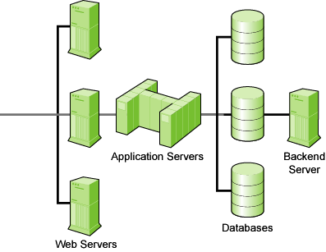

Web Application Architecture
Customer
App is deployed
here
Sensitive data is stored here
Internet
Firewall
Client Tier
(Browser)
Database
SSL
(Presentation)
App Server
(Business
Logic)
Protects Transport
Protects Network
Data Tier
Middle Tier

Slide 89
Application Security Problems
Root Cause:
  Developers are not trained to write or test for secure code
  Network security (firewall, IDS, etc) does not protect the Web Application Layer
Current State:
  Organizations test tactically at a late & costly stage in the SDLC
  A communication gap exists between security and development as such vulnerabilities are not fixed
  Testing coverage is incomplete

Slide 90
Critical Web Application Security Vulnerabilities
Un-validated Parameters
Broken Access Control
Broken Account and Session Management
Cross-Site Scripting (XSS)
Buffer Overflows
Command Injection Flaws
Error Handling Problems
Insecure Use of Cryptography
Remote Administration Flaws
Web and Application Server Misconfiguration

Slide 91
(1). Un-validated Parameters
Information from web requests is not validated before being used by a web application.
Attackers can use these flaws to attack background components through a web application.

Slide 92
How to Protect ( Countermeasures)
Ensure that all parameters are validated before they are used.
  Data type (string, integer, real, etc.)
  Allowed character set
  Minimum and maximum length
  Whether null is allowed
  Whether the parameter is required or not
  Whether duplicates are allowed
  Numeric range
  Specific legal values (enumeration)
  Specific patterns (regular expressions)

Slide 93
(2). Broken Access Control
Restrictions on what authenticated users are allowed to do are not properly enforced.
Attackers can exploit these flaws to access other users' accounts, view sensitive files, or use unauthorized functions.

Slide 94
How to Protect ( Countermeasures)
Think through an application's access control and capture it in a web application security policy.
Some specific access control issues include:
  Insecure Id's
  Forced Browsing Past Access Control Checks
  Path Traversal
  File Permissions
  Client Side Caching

Slide 95
Broken Account and Session Mgmt.
Account credentials and session tokens are not properly protected.
Attackers that can compromise passwords, keys, session cookies, or other tokens can defeat authentication restrictions and assume other users' identities.

Slide 96
How to Protect ( Countermeasures)
Careful and proper use of custom or off the shelf authentication and session management mechanisms
  Password Change Controls
  Password Strength
  Password Storage
  Protecting Credentials in Transit
  Session ID Protection
  Account Lists
  Browser Caching
  Trust Relationships
  Backend Authentication

Slide 97
Cross-Site Scripting (XSS)
What is it?
  The web application can be used as a mechanism to transport an attack to an end user's browser.
  Malicious script echoed back into HTML returned from a trusted site, and runs under trusted context
What are the implications?
  A successful attack can disclose the end user's session token, attack the local machine, or spoof content to fool the user

Slide 98


Cross Site Scripting – The Exploit Process
Evil.org
5) Evil.org uses stolen
session information to
impersonate user
1) Link to bank.com
sent to user via
E-mail or HTTP
4) Script sends user’s
cookie and session
information without the user’s
consent or knowledge
User
bank.com
2) User sends script embedded as data
3) Script/data returned, executed by browser

Slide 99
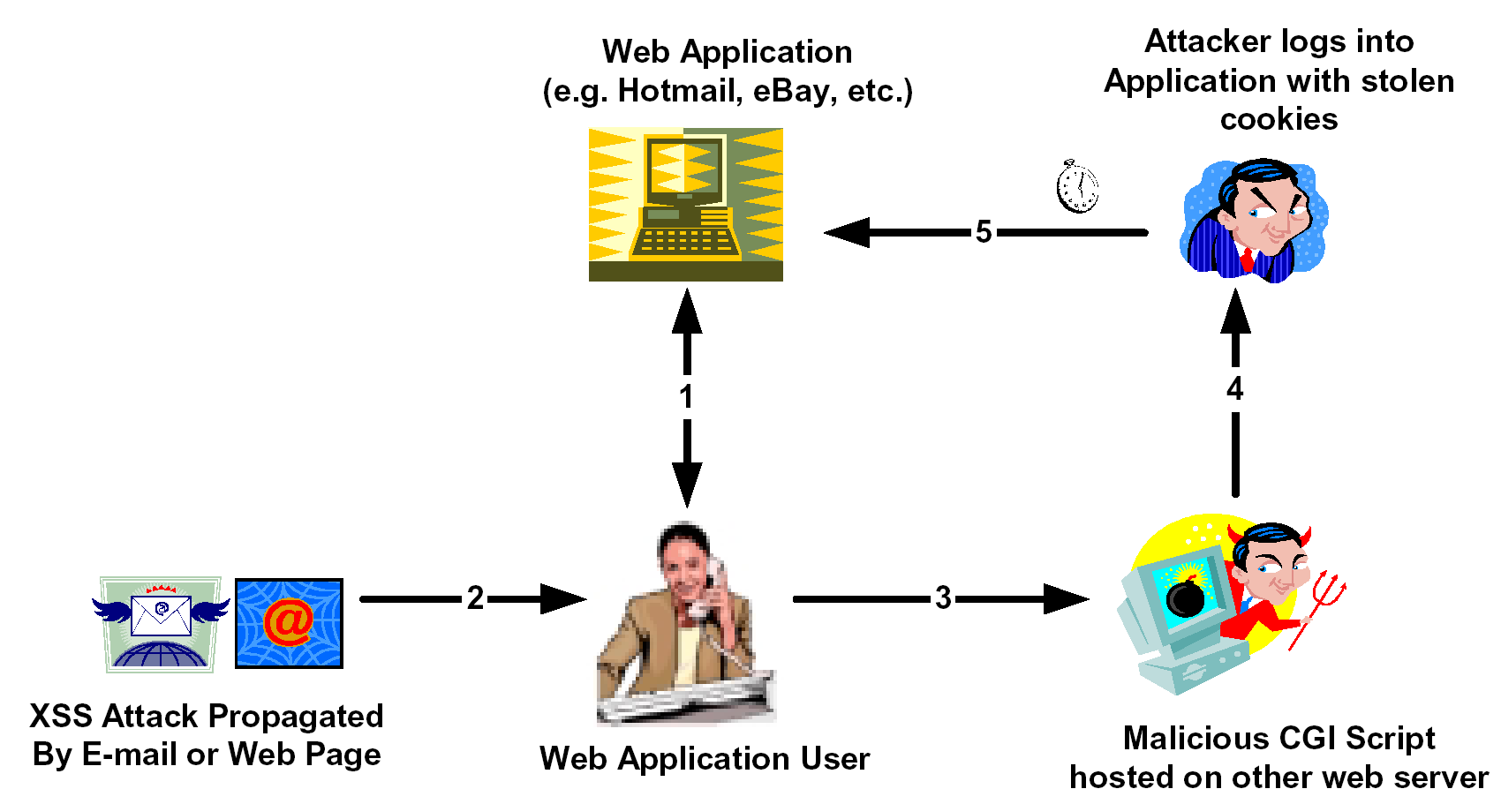
XSS Web Application Hijack Scenario
www.hacker.com

Slide 100
XSS – Details
Common in Search, Error Pages and returned forms.
  But can be found on any type of page
Any input may be echoed back
  Path, Query, Post-data, Cookie, Header, etc.
Browser technology used to aid attack
  XMLHttpRequest (AJAX), Flash, IFrame…
Notes:
DOM: Document object model

Slide 101
Exploiting XSS
If I can get you to run my JavaScript, I can…
  Steal your cookies for the domain you’re browsing
  Track every action you do in that browser from now on
  Redirect you to a Phishing site
  Completely modify the content of any page you see on this domain
  Exploit browser vulnerabilities to take over machine
  …
XSS is the Top Security Risk today (most exploited)

Slide 102
How to Protect ( Countermeasures)
Detailed code review that searches the code for validation of all headers, cookies, query strings, form fields, and hidden fields (i.e., all parameters)
Notes:
Dangerous Characters for Cross Site Scripting should be avoided/ checked

Slide 103
Buffer Overflows
Web application components in some languages that do not properly validate input can be crashed and, in some cases, used to take control of a process.
These components can include CGI, libraries, drivers, and web application server components.

Slide 104
How to Protect ( Countermeasures)
Keep up to date with the latest bug reports for your web and application server products and other products in your Internet infrastructure.
Apply the latest patches to these products.
Review all code that accepts input from users via the HTTP request and ensure that it provides appropriate size checking on all such inputs.

Slide 105
Command Injection Flaws
Web applications pass parameters when they access external systems or the local operating system.
  User-supplied data is sent to an interpreter as part of a command, query or data.
If an attacker can embed malicious commands in these parameters, the external system may execute those commands on behalf of the web application.
What are the implications?
  SQL Injection – Access/modify data in DB
  SSL Injection – Execute commands on server and access sensitive data
  LDAP Injection – Bypass authentication
  …

Slide 106
SQL Injection
User input inserted into SQL Command:
  Get product details by id:
  Select * from products where id=‘$REQUEST[“id”]’;
  Hack: send param id with value ‘ or ‘1’=‘1
  Resulting executed SQL:
  Select * from products where id=‘’ or ‘1’=‘1’
  All products returned
Notes:
SQL Injection occurs when user input is embedded as-is inside a pre-built SQL query. For example:
Let’s assume that our web application receives a product ID as input, and presents that product’s page. The SQL query looks like this:
“Select * from products where id=‘” + $REQUEST[‘id’];
You should note, that the query is basically a text string, and user input is concatenated to it. In this example, the user string is surrounded by apostrophes. Let’s take a look at what will happen if we submit the product ID value of ‘ or ‘’=‘
The query will be:
SELECT * from products where id=‘’ or ‘’=‘’;
You should pay attention to the fact that the WHERE criteria here is basically a Boolean TRUE.
Since the results of this query matches every entry in the database, all the products will be returned.

Slide 107
How to Protect ( Countermeasures)
Avoid the use of commands where possible.
Carefully validate the data provided to ensure that it does not contain any malicious content.
Ensure that the web application runs with only the privileges it absolutely needs to perform its function.
Any user information that is being inserted into the command should be rigorously checked.

Slide 108
Error Handling Problems
Error conditions that occur during normal operation are not handled properly.
If an attacker can cause errors to occur that the web application does not handle, they can gain detailed system information, deny service, cause security mechanisms to fail, or crash the server.

Slide 109
How to Protect ( Countermeasures)
A specific policy for how to handle errors should be documented.
Ensure that the site is built to gracefully handle all possible errors.
Certain classes of errors should be logged to help detect implementation flaws in the site and/or hacking attempts.

Slide 110
Insecure Use of Cryptography
Web applications frequently use cryptographic functions to protect information and credentials.
These functions and the code to integrate them have proven difficult to code properly, frequently resulting in weak protection.
E.g. MD5(CreditCardNum, RandomNum)

Slide 111
How to Protect ( Countermeasures)
Minimize the use of encryption and only keep information that is absolutely necessary.
Choose a library that has been exposed to public scrutiny and make sure that there are no open vulnerabilities.
Encapsulate the cryptographic functions that are used and review the code carefully.
Be sure that secrets, such as keys, certificates, and passwords, are stored securely.

Slide 112
Remote Administration Flaws
Many web applications allow administrators to access the site using a web interface.
If these administrative functions are not very carefully protected, an attacker can gain full access to all aspects of a site.

Slide 113
How to Protect ( Countermeasures)
Never allow administrator access through the front door if at all possible.
The use of strong authentication such as certificates, token based authenticators,...
The use of encryption (e.g., VPN or SSL) for the entire administrative session.
Interfaces be separate from interfaces provided to normal users.
Network separation or IP filtering.

Slide 114
Web and Application Server Misconfiguration
Having a strong server configuration standard is critical to a secure web application.
These servers have many configuration options that affect security and are not secure out of the box.

Slide 115
How to Protect ( Countermeasures)
Create a hardening guideline for configuration:
  Configuring all security mechanisms
  Turning off all unused services
  Setting up roles, permissions, and accounts
  Logging and alerts
Configuration maintenance:
  Monitoring the latest security vulnerabilities published
  Applying the latest security patches
  Updating the security configuration guideline
  Regular vulnerability scanning from both internal and external perspectives
  Regular status reports to upper management documenting overall security posture

Slide 116
Security Guidelines
Validate Input and Output
Fail Securely (Closed)
Keep it Simple
Use and Reuse Trusted Components
Defense in Depth
Only as Secure as the Weakest Link
Security By Obscurity(anonymity) Won't Work
Least Privilege
Compartmentalization (Separation of Privileges)

Slide 117
Validate Input and Output
All user input and user output should be checked to ensure it is both appropriate and expected.
Allow only explicitly defined characteristics and drop all other data.

Slide 118
Fail Securely (Closed)
When it fails, it fails closed.
  It should fail to a state that rejects all subsequent security requests.
A good analogy is a firewall. If a firewall fails it should drop all subsequent packets.

Slide 119
Keep it Simple
If a security system is too complex for its user base, it will either not be used or users will try to find measures to bypass it.
This message applies equally to tasks that an administrator must perform in order to secure an application.

Slide 120
Use and Reuse Trusted Components
Using and reusing trusted components makes sense both from a resource stance and from a security stance. When someone else has proven they got it right, take advantage of it.

Slide 121
Defense in Depth
Relying on one component to perform its function 100% of the time is unrealistic.
While we hope to build software and hardware that works as planned, predicting the unexpected is difficult.
Good systems don't predict the unexpected, but plan for it.

Slide 122
Only as Secure as the Weakest Link
Careful thought must be given to what one is securing.
Attackers will find the weakest point and attempt to exploit it.

Slide 123
Security By Obscurity Won't Work
It's simple to think that hiding things from prying eyes doesn't buy some amount of time.
This strategy doesn't work in the long term and has no guarantee of working in the short term.

Slide 124
Compartmentalization (Separation of Privileges)
Compartmentalizing users, processes and data helps contain problems if they do occur.
Compartmentalization is an important concept widely adopted in the information security realm.

Slide 125
Thank You !

