Slide 1
Unit 4: Authentication and Access Control

Slide 2
Outline
Overview of access control
Authentication and Authorization
Identification and authentication techniques
Access control techniques
Access control methodologies, implementations and administration

Slide 3
Access Controls
Access control is the collection of mechanisms that permits managers of a system to exercise a directing or restraining influence over the behavior, use, and content of a system. It permits management to specify what users can do, which resources they can access, and what operations they can perform on a system.

Slide 4
Access Control: Overview
Access Controls: The security features that control how users and systems communicate and interact with one another.
Access: The flow of information between subject and object
Subject: An active entity that requests access to an object or the data in an object
Object: A passive entity that contains information
Security Principle
CIA Trade

Slide 5
Identification, Authentication, and Authorization
Identification, Authentication, and Authorization are distinct functions.
Identification
Method of establishing the subject’s (user, program, process) identity.
Authentication
Method of proving the identity.
Authorization
Determines that the proven identity has some set of characteristics associated with it that gives it the right to access the requested resources.

Slide 6
Identification
Identification
Method of establishing the subject’s (user, program, process) identity.
Use of user name or other public information.
Know identification component requirements.
When issuing identification values to users, the following should be in place:
Each value should be unique, for user accountability;
A standard naming scheme should be followed;
The value should be non-descriptive of the user’s position or tasks.

Slide 7
Authentication
Authentication
Method of proving the identity.
Something a person is, has, or does.
Use of biometrics, passwords, passphrase, token, or other private information.
Strong Authentication is important
To be properly authenticated, the subject is usually required to provide a second piece to the credential set (i.e., password, passphrase, key, PIN, token etc).

Slide 8
Authentication Methods
There are 3 primary authentication methods. Sensitive or critical information should be protected by employing at least two of them (two-or three-factor authentication).
Knowledge -Something you know, such as a password, passphrase or PIN.
Ownership -For example, tokens and Smart cards.
Characteristics -Biometrics are digitized representations of physical features (such as fingerprints) or physical actions (such as signatures).

Slide 9
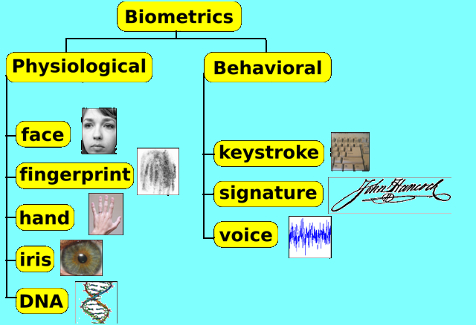
Authentication
Biometrics
Verifies an identity by analyzing a unique person attribute or behavior (e.g., what a person “is”).
Most expensive way to prove identity, also has difficulties with user acceptance.
Many different types of biometric systems, know the most common.

Slide 10
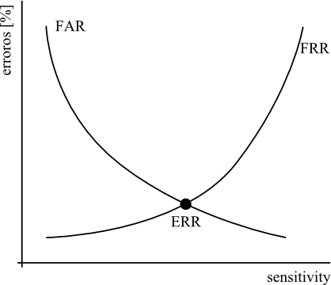
Authentication
Biometric systems can be hard to compare.
Type I Error: False rejection rate.
When a biometric system rejects an authorized individual
Type II Error: False acceptance rate.
When a biometric system accepts an individual who should have been rejected
This is an important error to avoid.
Crossover Error Rate
Rating stated as a percentage and represents the point at which the false rejection rate equals the false acceptance rate.

Slide 11
Authentication
Passwords
User name + password most common identification, authentication scheme.
Weak security mechanism, must implement strong password protections
Techniques to attack passwords
Electronic monitoring
Access the password file
Brute Force Attacks
Dictionary Attacks
Social Engineering

Slide 12
Authentication
One Time Passwords (aka Dynamic Passwords)
Used for authentication purposes and are only good once.
This type of system is not vulnerable to electronic eavesdropping, sniffing, or password guessing.
Two types of Token Devices (aka Password Generator)
Synchronous
Time Based
Counter Synchronization
Asynchronous

Slide 13
Authentication
Smart Cards and Memory Cards
Memory Cards: Holds but cannot process information.
Smart Cards: Holds and can process information. Has a microprocessor and integrated circuits incorporated into the card itself.
Contact
Contactless
Significant benefit of smart cards is that the authentication process occurs at the reader, thereby avoiding the trusted-path (protecting logon information between the user and the authentication server) problem.

Slide 14
Authorization
Authorization
Determines that the proven identity has some set of characteristics associated with it that gives it the right to access the requested resources.
Granting access rights to subjects should be based on the level of trust a company has in a subject and the subject’s need to know.
Is a core component of every operating system and established whether a user is authorized to access a particular resource and what actions he is permitted to perform on the resource

Slide 15
Authorization
Access Criteria can be thought of as:
Roles
Is an efficient way to assign rights to a type of user who performs a certain task. (job assignment or function).
Groups
When several users require same type of access to information and resources
Location
To restrict unauthorized individuals from being able to get in and reconfigure the server remotely.
Time
Restrict the times that certain actions or services can be accessed.
Transaction Types
Can be used to control what data is accessed during certain types of functions and what commands can be carried out on the data.

Slide 16
Authorization
Authorization concepts to keep in mind:
Authorization Creep
When new access rights and permissions assigned to employee without the old permissions being reviewed and removed.
Default to Zero
All access controls should be based on the concept of starting with zero access and then building on top of that.
Need to Know Principle
individuals should be given access only to the information that they absolutely require in order to complete their job duties.
Access Control Lists
A list of subjects that are authorized to access a particular object.

Slide 17
Authorization
Problems in controlling access to assets:
Different levels of users with different levels of access
Resources may be classified differently
Diverse identity of data
Corporate environments keep changing
Solutions that enterprise wide and single sign on solutions supply:
User provisioning
Password synchronization and reset
Centralized auditing and reporting
Integrated workflow (increase in productivity)
Regulatory compliance

Slide 18
Authorization
Single Sign On (SSO) Capabilities
Allow user credentials to be entered one time and the user is then able to access all resources in primary and secondary network domains
SSO technologies include:
Kerberos
Sesame
Security Domains
Directory Services
Dumb Terminals

Slide 19
SSO Process
SSOs enable users to logon to the authentication server and still obtain access to all additional authorized networked systems without additional identification and authentication.
SSO is also referred to as reduced sign-on, and is used in web-based environments in federated ID management systems.

Slide 20
SSO Technologies
Legacy Single Sign-On (SSO)
Although many legacy systems do not support an external means to identify and authenticate their users, it is possible to store user credentials centrally, and automatically enter them where and when needed.
The SSO system stores every user’s password to every system. This causes concern with respect to availability: if the SSO system fails, denial of service results.
If the SSO is compromised, controls over access to all systems may be lost.
Kerberos
An SSO open-standards protocol for authentication in a single security domain.
Kerberos is an authentication protocol that uses symmetric key encryption in three key pairs: two authentication pairs are shared by the authenticator and a single principal and one session pair is shared between principals.
The session-key pair is distributed in such a way that principals are required to trust the authenticator rather than each other.
SESAME
The Secure European System for Applications in a Multi-Vendor Environment (SESAME) is a protocol developed by the European Union that addresses multiple or disparate security domains.

Slide 21
SSO : Pros and Cons
Pros :
Efficient log-on process -The user logs on only once to access all authorized systems.
Encourages users to create stronger passwords -With only one password to remember and control, users may be inclined to use passwords that are harder and more difficult to crack. Fewer passwords to manage should also result in fewer being written down in unsafe locations.
Centralized administration -Ensures consistent application of policy and procedures.
Cons :
Single point of compromise -A single compromised sign-in allows the intruder into all of the account owner‟s authorized resources.
Legacy Interoperability-It may be difficult to include unique computers or legacy systems in the single sign on network.
Implementation difficulties-Unusual types of systems may not interface well with SSO software.

Slide 22
Access Control Models
Three Main Types
Discretionary (Unrestricted)
Mandatory
Non-Discretionary (Role Based)
Discretionary Access Control (DAC)
A system that uses discretionary access control allows the owner of the resource to specify which subjects can access which resources.
Access control is at the discretion of the owner.

Slide 23
Access Control Models
Mandatory Access Control (MAC)
Access control is based on a security labeling system. Users have security clearances and resources have security labels that contain data classifications.
This model is used in environments where information classification and confidentiality is very important (e.g., the military).
Non-Discretionary (Role Based) Access Control Models
Role Based Access Control (RBAC) uses a centrally administered set of controls to determine how subjects and objects interact.
Is the best system for an organization that has high turnover.

Slide 24
Access Control Techniques
There are a number of different access controls and technologies available to support the different models.
Rule Based Access Control
Constrained User Interfaces
Access Control Matrix
Content Dependent Access Control
Context Dependent Access Control

Slide 25
Access Control Techniques
Rule Based Access Control
Uses specific rules that indicate what can and cannot happen between a subject and an object.
Not necessarily identity based.
Traditionally, rule based access control has been used in MAC systems as an enforcement mechanism.

Slide 26
Access Control Techniques
Constrained User Interfaces
Restrict user’s access abilities by not allowing them certain types of access, or the ability to request certain functions or information
Three major types
Menus and Shells
Database Views
Physically Constrained Interfaces

Slide 27
Access Control Techniques
Access Control Matrix
Is a table of subjects and objects indicating what actions individual subjects can take upon individual objects.
Two types
Capability Table (bound to a subject)
Access Control List (bound to an object)

Slide 28
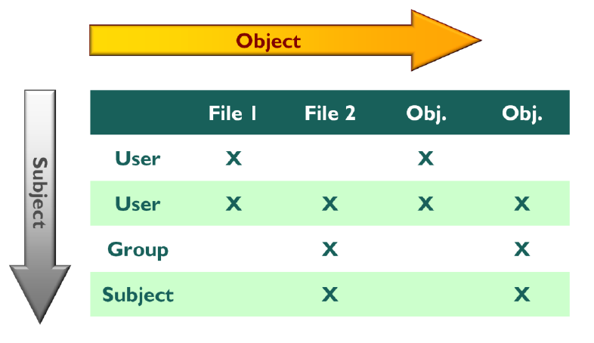
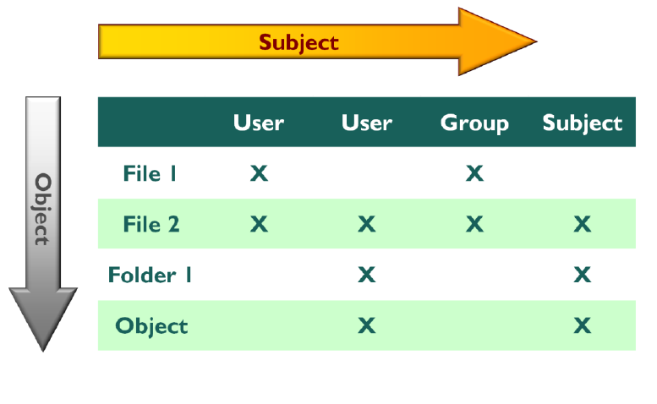
Access Control Matrix
Object-Oriented Capability Table: Is a collection of access control lists implemented by comparing the column of objects to the rows of subjects.
Subject-Oriented Capability Table:
Is a collection of access control lists implemented by comparing the column of users or subjects to their rights of access to protected objects.

Slide 29
Access Control Techniques
Content Dependent Access Control
Access to an object is determined by the content within the object.
Context Based Access Control
Makes access decision based on the context of a collection of information rather than content within an object.
First an organization must choose the access control model (DAC, MAC, RBAC).
Then the organization must select and implement different access control technologies.
Access Control Administration comes in two basic forms:
Centralized
Decentralized

Slide 30
Access Control Administration
Centralized Access Control Administration:
One entity is responsible for overseeing access to all corporate resources.
Provides a consistent and uniform method of controlling access rights.
Protocols: Agreed upon ways of communication
Attribute Value Pairs: Defined fields that accept certain values.
Types of Centralized Access Control
Radius
TACAS
Diameter
Notes:
All references are from All in One Book (Shon Harris, 2005)

Slide 31
RADIUS
Remote Authentication Dial In User Service.
Is a client/server authentication protocol and authenticates and authorizes remote users.
Most ISPs uses Radius to authenticate customers before they are allowed to access the Internet.
Radius is an open protocol and can be used in different types of implementations.
Uses UDP as a transport protocol
Only encrypts the user’s password as it is being transmitted from Radius client to the radius server.
Is appropriate protocol when simplistic username/password authentication can take place and users only need an “accept” or “deny” for obtaining access.

Slide 32
TACACS
Terminal Access Controller Access Control System
Uses TCP as a transport protocol.
Encrypts all user data and does not have the vulnerabilities that are inherent in the radius protocol.
Presents true AAA (Authentication, authorization, and accounting) architecture.

Slide 33
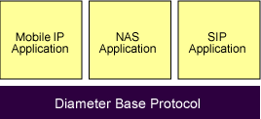
Diameter
Protocol that has been developed to build upon the functionality of radius and overcome many of its limitations.
It is an IETF standard defined in (RFC 3588)
The various applications that require AAA functions can define their own extensions on top of the Diameter base protocol, and can benefit from the general capabilities provided by the Diameter base protocol.

Slide 34
Access Control Administration
Decentralized Access Control Administration:
Gives control of access to the people who are closer to the resources
Has no methods for consistent control, lacks proper consistency.

Slide 35
Accountability
Accountability is tracked by recording user, system, and application activities.
Audit information must be reviewed
Event Oriented Audit Review
Real Time and Near Real Time Review
Audit Reduction Tools
Variance Detection Tools
Attack Signature Tools

Slide 36
Accountability
Other accountability concepts
Keystroke Monitoring
Can review and record keystroke entries by a user during an active session.
May have privacy implications for an organization
Scrubbing: Removing specific incriminating (implicating) data within audit logs

Slide 37
Access Control Practices
Know the access control tasks that need to be accomplished regularly to ensure satisfactory security. Best practices include:
Deny access to anonymous accounts
Enforce strict access criteria
Suspend inactive accounts
Replace default passwords
Enforce password rotation
Audit and review
Protect audit logs

Slide 38
Access Control Practices
Unauthorized Disclosure of Information
Object Reuse
Data Hiding
Emanation Security
Tempest
Project started by the DoD and then turned into a standard that outlines how to develop countermeasures that control spurious electrical signals that are emitted by electronic equipment.
White Noise
A uniform spectrum of random electrical signals.
Control Zone
Creates a security perimeter and is constructed to protect against unauthorized access to data or compromise of sensitive information.

Slide 39
Access Control Monitoring
Intrusion Detection
Three Common Components
Sensors
Analyzers
Administrator Interfaces
Common Types
Intrusion Detection
Intrusion Prevention
Honeypots
Network Sniffers

Slide 40
Access Control Monitoring
Two Main Types of Intrusion Detection Systems
Network Based (NIDS)
Host Based (HIDS)
HIDS and NIDS can be:
Signature Based
Statistical Anomaly Based
Protocol Anomaly Based
Traffic Anomaly Based
Rule Based

Slide 41
Access Control Monitoring
Intrusion Prevention Systems
Is a preventative and proactive technology, IDS is a detective technology.
Two types: Network Based (NIPS) and Host Based (HIPS)
Honeypots
An attractive offering that hopes to lure attackers away from critical systems
Network sniffers
A general term for programs or devices that are able to examine traffic on a LAN segment.

Slide 42
Thank You !

